Slide 1
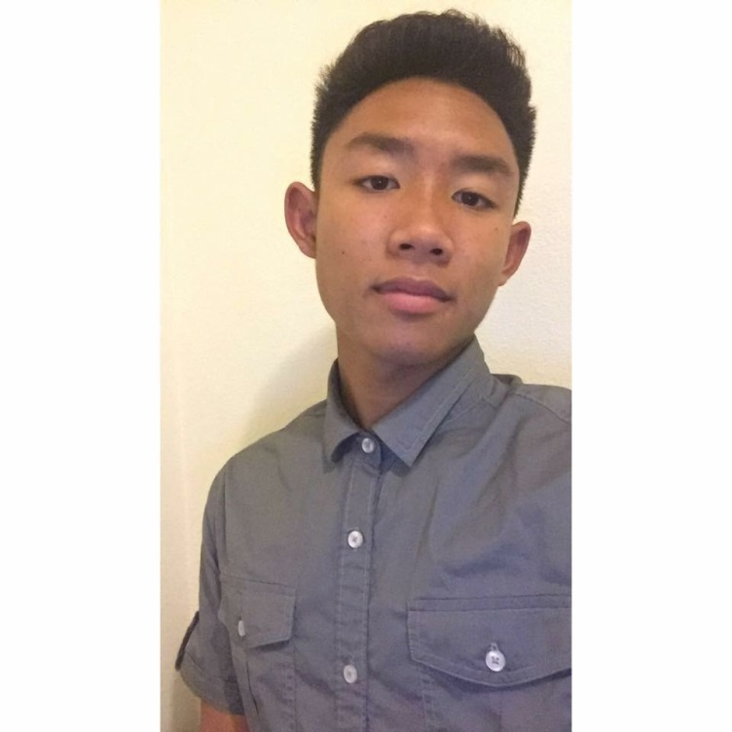
Senior exit interview Harry See

Slide 2
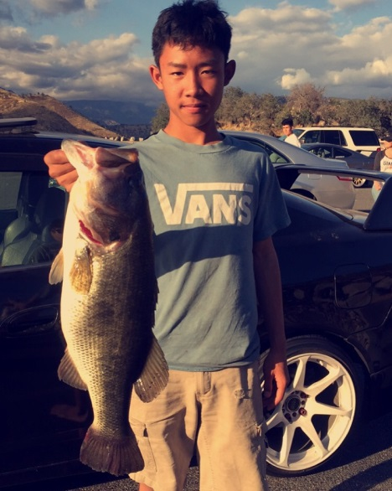
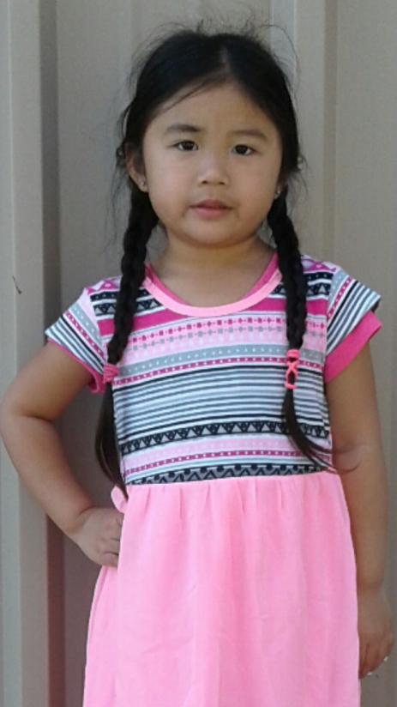
About me
17 years old
Born in August 31st
3 sisters and 1 brother
I drive a Honda
Listen to music a lot
I love fishing and hunting

Slide 3
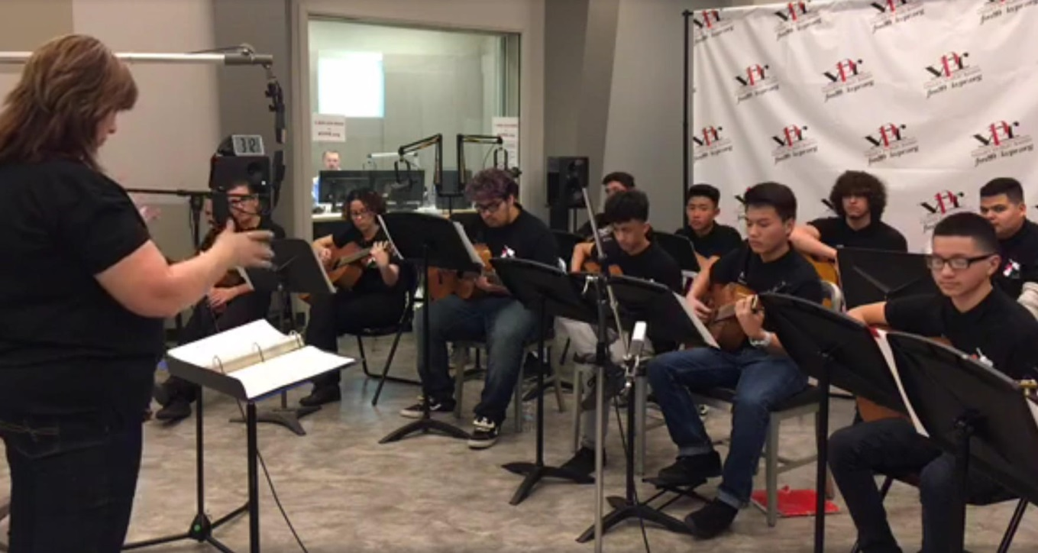
High School experience
Joined guitar club
Very challenging
Had memorable experiences

Slide 4
Job Shadow
Tire shop
Really wanted to work there
Suited me good because I'm really interested in cars

Slide 5
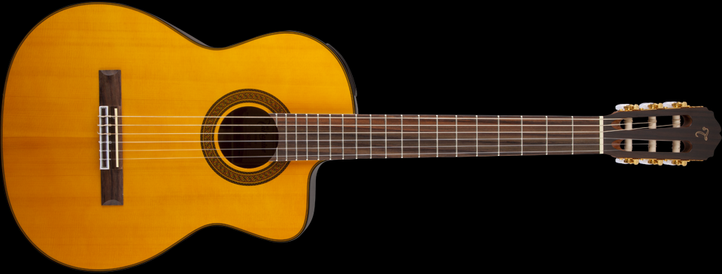
Pathway
Guitar
Wanted to be a professional guitar player
Taught me to calm down and relax
Taught me to be patient

Slide 6
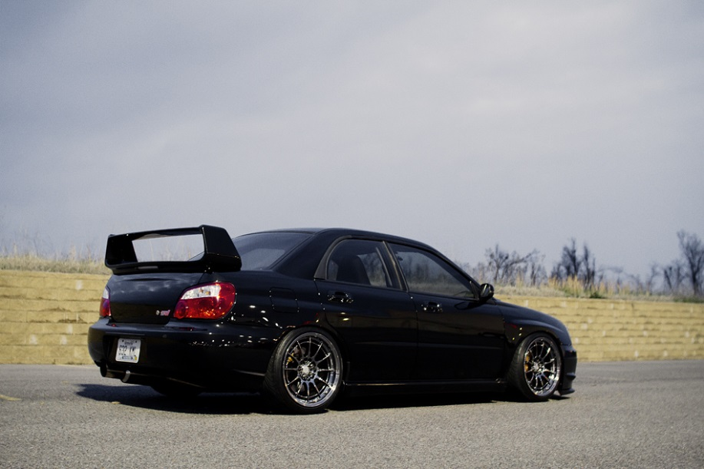
Post High school plans
Work
Buy my dream car
Travel

Slide 7
Leaving LHS
Miss staff and friends
Independent
Grew as a person

Slide 8
Thank you, Any questions?

